Slide 1
Leading with Values: How to Talk about Abortion aaboutAAbortionAbortion
May 2022

Slide 2
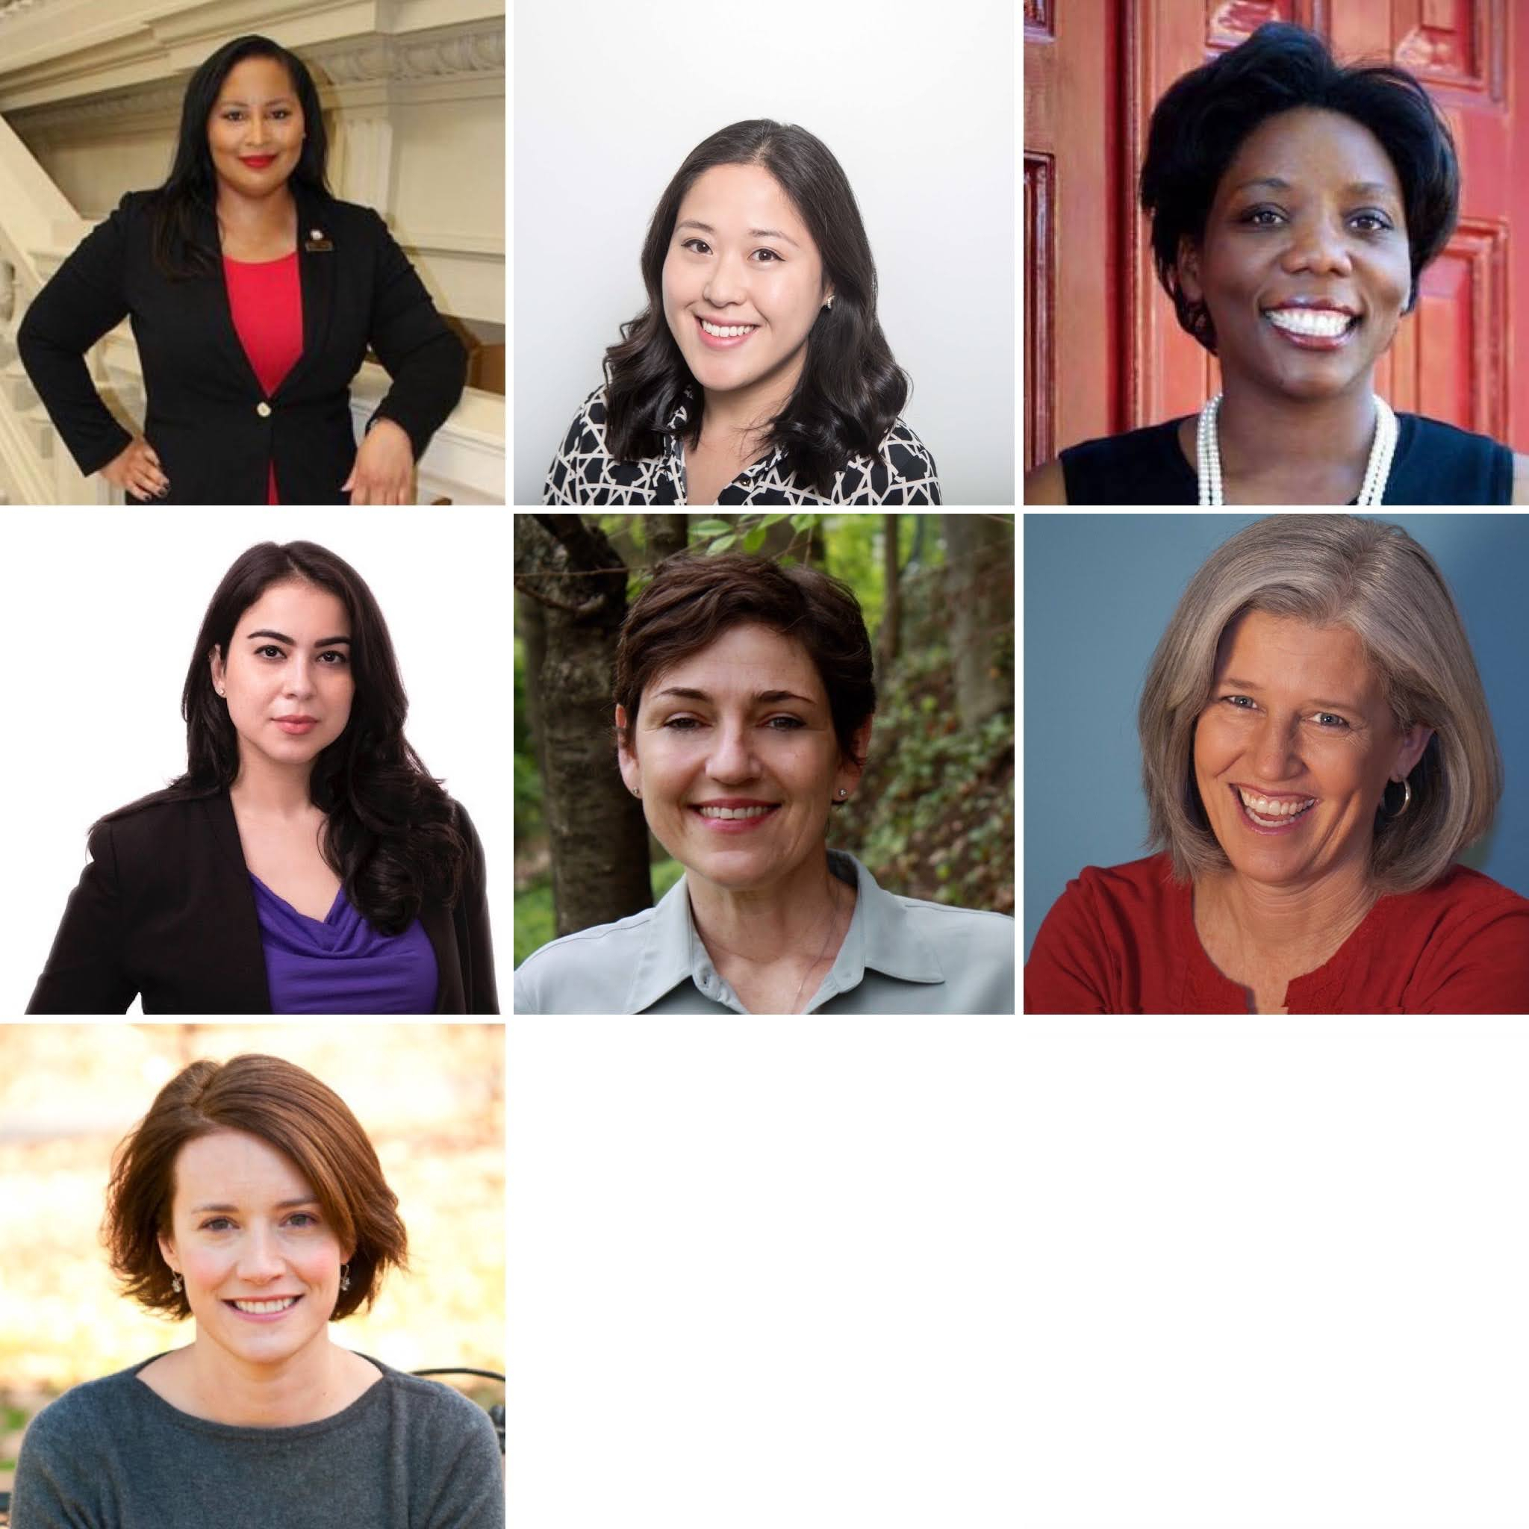
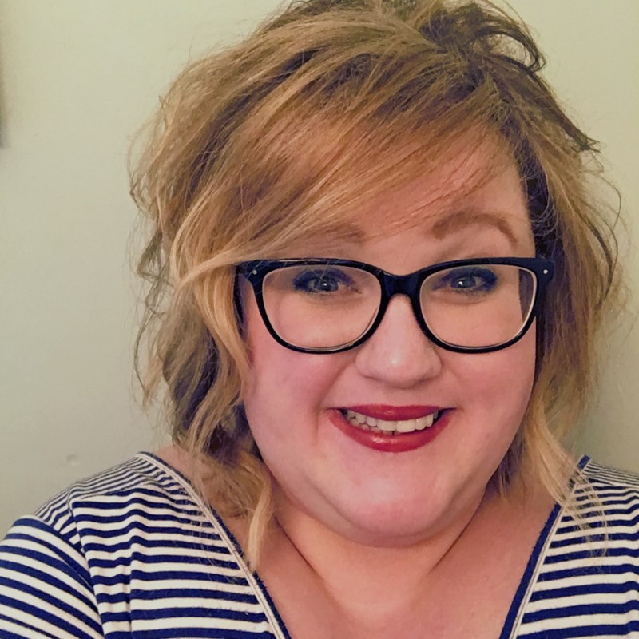
Our Team
Renitta Shannon, she/her
Jessica Giusti, she/her
Nicole Lewis, she/her
Yumhee Park, she/her
Catherine Lozada, she/her
Kate Stewart, she/her
Margaret Conway, she/her
Mary Alice Carter, she/her
Notes:
Kate Stewart- Co-Director
Catherine Lozada- Co-Director
Jessica Guisti- Director
Mary Alice Carter- Senior Strategist
Margaret Conway-Strategic Advisor
Nicole Lewis-Senior Project Manager
Renitta Shannon- Consultant

Slide 3
Gendered: “The reality is too many women in the U.S. face barriers to abortion care.”
Inclusive/Neutral: “The reality is too many people/patients in the U.S. face barriers to abortion care.”
Inclusive/Explicit: “The reality is that too many women, transgender, and nonbinary people in the U.S. face barriers to abortion care.”
Language

Slide 4
If a person’s framing doesn’t match the facts, the facts get thrown out
Deeper connection with the listener
Turns down the heat
Connects support for broad range of issues
Why Lead with Values?

Slide 5
Leading with Shared Values
Health Autonomy Fair Treatment
values
Civil Rights
Health Care
Taxes
K-12 Education
Jobs
Earned Income Tax Credit
Title X
School Vouchers
Medicaid Funding
issues
policies

Slide 6
Values
Autonomy and Agency
Health and Wellbeing
Freedom
Rights
Dignity
Justice and Equity

Slide 7
Practice
What is your nine-word purpose statement?

Slide 8
Barriers & Motivators
Barriers | Motivators
Irresponsible | Respecting personal decision-making
Abortion as birth control | No political interference
Too many abortions; too young | Not for me to judge
Immoral | Avoid pushing people into poverty
Discomfort | Health
Don’t take it seriously, dangerous | Gender equality; women’s equality

Slide 9
Reducing Pushback
Instead of… | Say… | Why?
Choice | Abortion; personal decision; important life decision | A “decision” is more serious than “choice,” which can be perceived as less thoughtful and impulsive.
Pro-choice or Pro-life | Support person’s decisions Anti-abortion; abortion opponents | People often identify as pro-life and pro-choice so the labels are not useful in messaging.
Deserves | Ability; need; should be able to | “Deserves” is a term that can result in pushback from audiences.
Using the terms “fair,” “unfair,” “fairness” | We should not treat people different just because… they are working to make ends meet; live in a certain zip code; of their race; gender; etc. | “Fair, unfair, fairness” are terms that can result in pushback from audiences.

Slide 10
Avoiding Stigma
Instead of… | Say… | Why?
“Devastating decision” or “no one wants an abortion” | “Deeply personal decision” and “We don’t know the circumstances” | Convey seriousness without stigma or assuming anything about the feelings of the person having the abortion.
Listing details or reasons why someone is having an abortion (e.g. rape, incest, etc.) | Mention the decision-making process: “thinking through the decision;” “talking it over with loved ones.” Remind the audience that “the person has made their decision.” | Listing reasons or exceptions increases judgment and can lead to support for restrictions.
 | We trust people to know what they need. People come to this decision with their families, faith, and future in mind.

Slide 11
Avoiding Stigma
Instead of… | Say… | Why?
Stereotypes (e.g. poor, dependent on gov’t funding) | Family/person working to make ends meet | Reduce stereotyping and judgment.
Abortion should be “safe, legal, and rare” | Abortion must be available and affordable | Saying “rare” increases stigma and can create support for restrictions.
We can’t go back to pre-Roe days with women dying from back alley abortions | We all want to live a safe and healthy life and be free to define our own path. | So much has changed since 1973, including access to medication abortion care. Threats of people dying are less believable and not helpful. Communicate positive values and connect to people’s lives to build support.
Demonizing government’s role | Some policymakers or special interests who want to impose their values on others | The gov’t has a role in ensuring access to a full range of healthcare, including abortion care.

Slide 12
Connecting with your audience…
Acknowledge complex or conflicting views and model empathy:
We all have strong feelings about pregnancy… However we feel about abortion…
Say “we” and “us” rather than “they” or “them”
“It’s not for me or anyone to judge” “It’s not my / our place”
Sometimes: “Don’t stand in the way” (rather than “support”)

Slide 13
Message Triangle
VISION
PROBLEM
CORE MESSAGE
SOLUTION

Slide 14
Values Message Triangle
VISION & VALUES
We envision a world that leads with compassion and where we put people’s health, safety, and real-life needs ﬁrst, where families thrive, and where each of us lives with dignity and equality.
IMPACT
Politicians have denied our freedom to make decisions about our health, our bodies, and our families.
CORE MESSAGE
We aren’t truly free unless we can make our own decisions and have the freedom to deﬁne our own path.
SOLUTION
It’s time to speak up and show up to make sure people can live with dignity and respect.

Slide 15
We aren’t truly free unless we can make our own decisions and have the freedom to deﬁne our own path.
Core Message
People are rising up for racial justice, economic justice, and reproductive justice. We are working toward a future in which we can all control our own bodies, safely care for our families, and be free from government-sanctioned violence.

Slide 16
We envision a world that leads with compassion and where we put people’s health, safety, and real-life needs first, where families thrive, and where each of us lives with dignity and equality.
Values/Vision
Access to birth control and abortion care helps to make sure that people can stay healthy and thrive.

Slide 17
Politicians have denied our freedom to make decisions about our health, our bodies, and our families.
Problem/Impact
Legality alone has never been enough to secure real access to abortion care. When someone has made the decision to have an abortion, no one should get in their way, especially politicians.
Anti-Black, anti-immigrant, anti-LGBTQ, anti-abortion movements -- are all rooted in white supremacy and deny people their basic human rights and freedom.

Slide 18
It’s time to speak up and show up to make sure people can live with dignity and respect.
Each of us is the best expert in our own lives and communities. We are creating a future in which we can control our own bodies, safely care for our families, and be free from violence.
Fair wages, decent working conditions, and being able to get reproductive healthcare, including abortion care, help to make sure that communities can be healthy and thrive.
Solution

Slide 19
Focus on the impact of the case, especially those who would be most harmed and have been harmed by restrictions.
Center the stories and experiences of pregnant people and those who help people access care.
Shift narrative away from viability (an opposition frame) and focus on impact.
Bring in positive values and vision. Remind people what they are for and not just what they are against.
SCOTUS

Slide 20
Our ability to make decisions about our lives and futures, including the decision to have an abortion, is on the line.
We must put people’s real-life needs first – because living a safe and healthy life is a basic right that includes being able to get abortion care, whoever we are and wherever we live.
We’re committed to a future where we all have the freedom to control our own bodies, safely care for our families, and live with dignity.
It’s time to ensure that abortion is not only legal, but also available and affordable.
SCOTUS

Slide 21
When showing support for birth control access don’t inadvertently undermine abortion care.
Avoid talking about access to birth control as a way to reduce or eliminate abortion. This stigmatizes abortion care. Put the focus on the power of individual decision making.
Don’t repeat opponents falsehoods about EC or IUDs. Instead debunk them and explain what they actually do.
Call out the tactics of the opposition to block all reproductive health care.
Birth Control & Abortion

Slide 22
The decision about whether, when, or how to become a parent is one of the most important life decisions we make. People should have access to birth control, abortion, prenatal care, and parenting support so they can make the decision that is best for themselves and their families.
Abortion and birth control are both important parts of health care and do different things. Birth control prevents pregnancy and does not interfere with an existing pregnancy. Abortion ends a pregnancy. Both should be available, affordable, and accessible.
People who oppose any type of reproductive health care falsely claim abortion and birth control are the same. It’s all part of a deliberate effort to block access to both.
Even if we remove all barriers to birth control, abortion care will still be necessary and is an integral part of the full spectrum of health care.
Birth Control & Abortion

Slide 23
Before & after
“Birth control reduces the number of abortions.”
“Birth control and abortion both help us make decisions about if, when, and how to become a parent.”
Notes:
Before:
“I remember the days of back-alley abortions, before Roe vs. Wade, and some people want to take us back to those dark days.”
After:
“We all want to live a safe and healthy life and be free to define our own path.”

Slide 24
Responding to Backlash/Misinformation
01
Don’t repeat opposition claims.
02
Answer questions quickly and directly.
03
Bring the conversation back to the threats and core values.

Slide 25
Dos & Don’ts
Do | Don’t
Use your message triangle and don’t be afraid to repeat messages. | Use technical terms and acronyms.
Focus on YOUR point, not just answering the question. | Get into the weeds.
Illustrate your points with examples or anecdotes. | Speculate. If you don’t know, use a pivot (more on that later).
 | Repeat opposition’s language.
Notes:
Interviews: It is not a conversation. Repeat yourself. Don’t fill the silence.

Slide 26
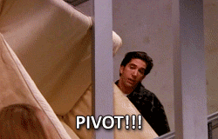
.
Pivots
Pivots are handy
Move conversation from hostile to your message
“Block” and pivot

Slide 27
I can’t speculate about that; what I can tell you is…
I’m not the best person to speak on that important topic, however…
We can’t do justice to such a complex topic in this short time…
…here’s what I do know [your focus] …
…where we can come to understanding is [your focus]
…the real issue is [your focus] …
…let me explain [your focus] …
…when you stop and think about it [your focus] …
Pivots

Slide 28
Has the science on viability or fetal development changed?
Question
Answer:
As any doctor will tell you, every pregnancy is different. That's why a patient’s health should guide their decisions throughout pregnancy. Right now, we need to make sure everyone can access abortion care in the way that ensures their wellbeing and puts their health and real-life needs first.
(If necessary) Let’s be clear that the Dobbs v. Jackson Women’s Health Organization Supreme Court case is about an abortion ban. Viability is simply not possible at or near 15 weeks of pregnancy.
Example

Slide 29
Don’t some types of birth control cause abortions?
Question
Answer:
Abortion and birth control are important parts of health care and do different things. Birth control prevents pregnancy, abortion ends a pregnancy.
People who oppose any type of reproductive health care falsely claim abortion and birth control are the same. It’s all part of a deliberate effort to block access to both. Both abortion and birth control should be available, affordable, and accessible so people can make the decisions that are best for themselves.
Example

Slide 30
Why can’t we just make birth control available and eliminate the need for abortion?
Question
Answer:
The decision about whether, when, or how to become a parent is one of the most important life decisions we make. People should have access to birth control, abortion, prenatal care, and parenting support so they can make the decision that is best for themselves and their families.
Even if we remove all barriers to birth control, abortion care will still be necessary and is an integral part of the full spectrum of health care.
We must remove harmful barriers to both.
Example

Slide 31
There are more crisis pregnancy centers than there are abortion clinics. Why don’t we just let
them care for pregnant women?
Question
Answer:
Anti-abortion centers or “fake health centers” lie and mislead people to discourage them from getting an abortion. They don’t offer any meaningful support to people who are pregnant or parenting and they stigmatize single parents.
These centers do not offer the care or support people need and cannot replace the trained medical experts who provide essential health care to people who are pregnant.
Example

Slide 32
Message Triangle
VISION
PROBLEM
CORE MESSAGE
SOLUTION

Slide 33
For More Information
Please visit the COMS Project website to request membership and get access to research reports, message documents, and materials.
www.comsproject.org
Can’t find what you’re looking for or want more information?
Please email us at hello@comsproject.org for assistance.

Slide 34
Thank You!
Catherine Lozada
catherine@conwaystrategic.com
Renitta Shannon
renitta@conwaystrategic.com

